Slide 1
Chapter 4: Preparing for the future
What can you do today to be prepared to enter the workforce in the future?

Slide 2
Prepare for the future
Three ways you can prepare now for your job prospects in the future are:
1. Think about the future (know what types of good and services will be in demand in the next 10-15 years.)
2. Get professional training (in the form of education, volunteer work, or job-shadowing.)
3. Reflect upon want you want to do, and what you can do. (in order to be economically empowered.)

Slide 3
Prepare for the future
Considering the following jobs. Which ones will be in demand in the future? Why?
Logger
Journalist
Teacher
Fisher person
Computer programmer
Hair stylist
Accountant

Slide 4
Types of jobs
Primary Sector (p. 61)
These jobs are linked to natural resources. It is the harvesting or extraction of these resources from the land or sea.
For example: agriculture, fishery, forestry, mining
Because of advancements in technology, this sector is different now than in the past.
For example: machines cut and gather wood now, and trucks transport that wood. Whereas, in the past a logger would have to cut the tree, and transport it down a river.

Slide 5
Types of jobs
Secondary sector (p. 61)
The construction, manufacturing of fabrication of primary resources.
For example: lumber mills, housing/building construction, oil refineries.
This can also include transforming natural resources into goods: for example, turning wood into furniture, packaging foods, making clothes, etc…

Slide 6
Types of jobs
Tertiary sector (p. 62)
Providing services to others; this could be anything in sales (grocery cashier, or a realtor), transportation, health care, teaching, the arts, or the government.

Slide 7
Types of jobs
Quaternary Sector (p. 62)
This concerns information and ideas.
For example: research scientists, computer programmers, bloggers, telemarketing, architectural designing.

Slide 8
A diversified economy
A diversified economy is: An economic system where the jobs are spread out through all sectors.
Today, the tertiary sector and the quaternary sector are where the majority of jobs in Canada are filled.
There are some jobs in the secondary sector
And there are few jobs in the primary sector.

Slide 9
A Global view (p. 67)
No national economy is separate from other economies.
Almost all countries make goods that are sold to other countries and buy goods that are made in other countries.
World economies rely on the notion of importing and exporting.
Import – a product bought from another country to be sold here in Canada.
Export – A Canadian product bought by another country to be sold there.

Slide 10
http://atlas.media.mit.edu/en/profile/country/can/

Slide 11
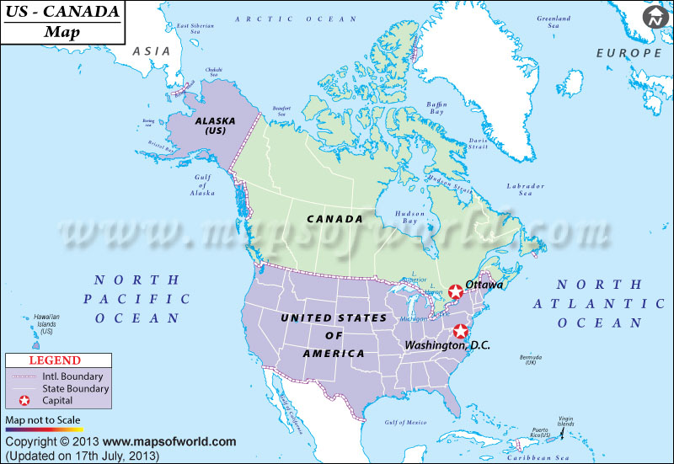
The effects of a global economy
Canada’s number one partner in importing and exporting (therefore a HUGE contributor to our economy is the United States.)
This is for two reasons:
1. Our physical proximity
2. Our similar culture

Slide 12
The effects of a global economy
With this idea, it means that Canada does not control its own economy. It must depend on other nations for growth, or also see loss if other nations see a financial loss.
World economies also influence politics as well. If countries depend heavily on each other for imports and exports, their leaders must also get along.
Reflect, and discuss: What if President Trump does not like the political moves of Justin Trudeau? What could that mean for Canada economically?

Slide 13
https://www.bnn.ca/economics/video/a-disgrace-trump-takes-fresh-aim-at-canada-s-dairy-lumber-energy~1105433

Slide 14
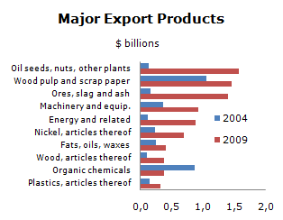
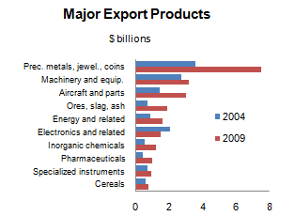
The effects of a world economy
Canada is one of the richest countries in the world in terms of our natural resources. However, we have a small population. Therefore, world commerce allows us to sell our products to a larger audience than Canadians alone.
Exports to China
Exports to England

Slide 15
Predicting the future (p. 70)
Economists are scientists who specialize in research on the findings of the economy. They analyse trends and information in order to inform the public about the national economy.
They make predictions by examining information based on trends and demographics.

Slide 16
Trends : causes and effets
A trend is anything that is popular at a given time. This could be an economic product, but could also be a way of thinking: which will eventually lead to a place in the economy.
Ex: People now are concerned with finding alternate sources for energy other than fossil fuels. This can lead to economic opportunities in green energy.

Slide 17
Demographics : causes and effets
Demographics are statistics on any component that makes up a population. For example, the number of people in a certain age category, their gender, their family type, their standard of living etc…
Economists analyse these demographics to determine how these things will impact our economy.
Ex: The Canadian population is aging. What effect could this have on our economy?

Slide 18
http://www.statcan.gc.ca/pub/11-402-x/2012000/chap/pop/pop-eng.htm

