Slide 1
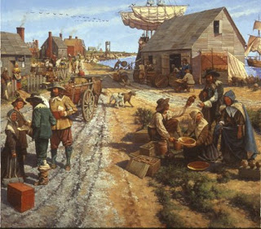
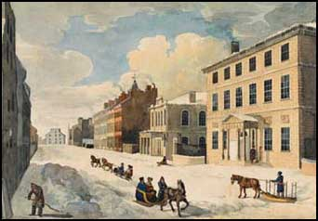
Chapter 5: Life in British North America
Life in British North America in the 19th century.

Slide 2
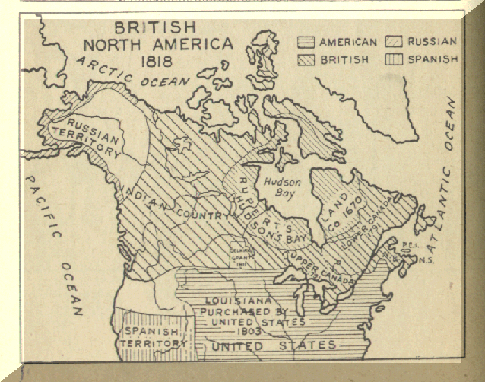
What is British North America?
The name of the region known as Canada now, but before the declaration of Canada as its own country (confederation in 1867).

Slide 3
The Politics of British North America
The 10 provinces and 3 territories as we know them now, did not exist. The following are examples of regions in BNA:
British Colonies (ex. Newfoundland)
First Nations region (ex. New Caledonia)
Hudson Bay Company region (ex. Rupert’s Land)
French region (ex. Canada East, the West coast of Newfoundland)
English region (ex. Canada West)
Go to page 76 to examine the map

Slide 4
Population demographics
There were approximately 2 500 000 inhabitants of BNA (British North America)
Most of these citizens lived in the eastern regions of the land.
85% of the populations lived in rural communities. Only 15% of the population lived in urban centers.

Slide 5
The Economy
The economy was controlled by descendants of European immigrants. Industries such as the fur trade, the fishery, agriculture, and forestry were the major economies of this period.
During this time, Aboriginal people fought to survive because of the negative consequences they suffered from the introduction of the European economic system.

Slide 6
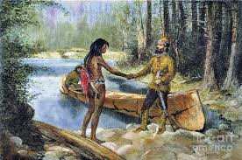
Brain storm #1
Think, consider, reflect back to earlier chapters:
What were these consequences felt by First Nations groups, Inuit, and Métis groups?

Slide 8
A Closer Look: Case Study
Turn to page 79 in your textbook. Listen and follow along to this information, then do the corresponding worksheet.

Slide 9
The population of BNA
As we have learned, the true first inhabitants of BNA, before it was declared BNA were the Aboriginals.
During the 1700s and 1800s immigrant populations started to grow.
Immigrant: a person who comes to a new place in the hopes of establishing permanent residence there.

Slide 10
Aboriginals
In the 19th century, Aboriginals were placed under the authority of the British colonial government even though they were not given rights to vote or to hold political power. They suffered through this racism by:
Losing their land and way of life
Losing their population
Racism: a prejudice based upon the colour of someone's skin.

Slide 11
The loss of land and way of life
Particularly in the regions of the province of Canada, and in the Atlantic crowned colonies. Aboriginals were made to leave fertile land (for crowing crops) and land next to useful resources (such as water or other sources of food).
The colonial government gave the Aboriginals a certain area of land (later known as reserves). These areas were usually isolated from others, far away from many natural resources, and very small.
https://www.youtube.com/watch?v=RQr9zpCWe5Q

Slide 12
The loss of their Population
After initial contact, many aboriginals died from disease (ex. Tuberculosis) because they did not have the resistance against these European sicknesses.
resistance – The body’s ability to fight off certain sicknesses efficiently.
Many died of famine because their resources were overhunted for the fur trade.
Rarely, though in some cases, there was loss of life due to conflict between Aboriginals and European settlers.
Read p. 86 and 87

Slide 13
The primary European immigrants were:
1. The British and Irish
2. The French
3. The Black colonists

Slide 14
The British Population
The British in the 1800s (including the Scottish) were considered the elite, - a social class with political, economic and social power.
Their largest populations were in Canada West, New Brunswick, Nova Scotia, PEI, and Newfoundland.
They had governmental influence and they owned the majority of businesses, so they controlled the economy.

Slide 15
The Irish Population
Between 1815 and 1850, a large wave of new Irish immigrants came to BNA, but their life was not easy:
English settlers already had prejudices against the Irish due to a long history in Europe of discrimination.
Prejudice – A negative thought against a group of people.
Discrimination – Negative treatment of a group of people because of a prejudice.
Read p. 82 & 83

Slide 16
The French Population
Most French descendants lived in Canada East. But quite a lot lived in Acadia (Acadie)- the maritime regions and the west coast of Newfoundland.
Canada East
- Because Montreal was a huge economic centre, some French were considered elite. However, most French settlers worked as farmers in rural parts of Canada East, and they called themselves des habitants
What are the Montreal Canadiens known as? Why?

Slide 17
The Acadian population
- The first French settlers (who, by the way, settled well before the British did), in Nova Scotia, New Brunswick, PEI and NL, called themselves the Acadians.
-However, the British elite government of BNA in these regions, deported them. In other words, they forced them to leave their land.
- Therefore, much like the Irish, they were often victims of discrimination.
Read p. 84 and 85
https://www.youtube.com/watch?v=zTtCtIg7kjA

Slide 18
Black Colonists
Slavery was legal in BNA up until 1834.
Therefore, after it became illegal, many African slaves from the US came to Canada in order to escape slavery.
Even though Black colonist were ‘free’ in BNA, they did not have the same rights as white settlers, due to racism.

Slide 19
Types of Black Settlers
Most Black settlers were:
1. escaping slavery in the US
2. Immigrants from the Caribbean islands
3. Immigrants from Africa
https://www.youtube.com/watch?v=zZ0BZWLn6wY

Slide 20
The Rights of the Black settlers
Much like the Aboriginals, they were victims of racism and discrimination.
1. They were not hired for many jobs and when they could find work, they were paid less than white workers.
2. As white communities grew and developed, black settlers were forced into smaller communities located farther way from resources (fertile land, fresh water, main waterways or carriage routes)
https://www.youtube.com/watch?v=1imr0T5U3Yc

