Slide 1
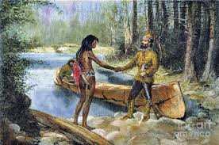
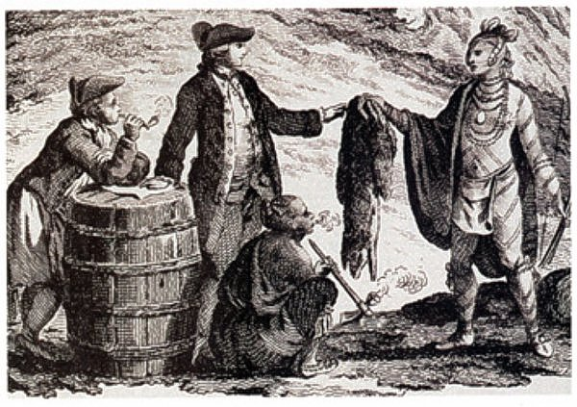
Chapter 2 Economies in History
What economic changes occurred when Europeans came to North America?

Slide 2
The way of life in the past Section 1
Terms to know:
Production : To create functional goods
(tools).
Distribution: How the goods are shared.
Need: A good necessary for survival.
Want: A good that can improve the way
of life.
Aboriginal: The first inhabitants of a region.

Slide 3
Preindustrial economy: a method of producing and distributing goods and services by way of mainly trading and sharing simple tools, made from natural resources.
Industrial economy: a method of producing and distributing goods and services by way of buying and selling more complex tools made in factories.
Post-industrial economy: a method of producing and distributing goods and services by way of virtual means (online) as well as buying and selling complex tools made in factories.

Slide 4
European: The new arrivals to North America. They mainly came from England, Ireland, Scotland or France.

Slide 5
Aboriginals
In Canada there are three separate Aboriginal groups recognized by the government:
1. Inuit: Aboriginals north of the Tree Line
2. First Nations: All other Aboriginal groups throughout Canada
3. Métis: Children of Inuit or First Nations mothers and European father.
Take a look at p. 26 of your text to see a more comprehensive list of First Nations groups.

Slide 6
https://www.youtube.com/watch?v=lh_ZVwsvYl4

Slide 7
Fait la feuille travail « Des Autochtones »

Slide 8
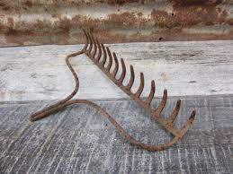
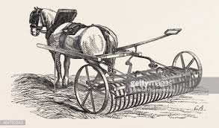
The Europeans
In the 1700s, Europeans developed an industrial economy. This means:
They used simple tools, but these tools were usually processed in factories such as smith shops.
Ex:

Slide 9
Fait l’étude en cas de «Sous la Loupe: Trois ressources importantes»

Slide 10
Please fill in this table to better understand the industrial economy of the Europeans.
 | Needs/wants | Production | Distribution
Europeans

Slide 11
Consequences of contact: Section 2
Terms to know
Contact: The time when Europeans first came to North America.
Colonisation: After contact, when Europeans started moving to North America permanently.
Treaty: An agreement between two or more nations.
Mamateek: The type of shelter of the Beothuk.
Beothuk: An aboriginal group who lived on the island of Newfoundland and suffered grave consequences due to European colonisation.

Slide 12
But, why did the Europeans leave Europe?
The Europeans came to North America because:
The wanted to promote and spread their religion and way of life.
They were looking for new economic possibilities.
The were looking for natural resources (linked to the economy!).

Slide 13
Treaties
The British colonists convinced the Aboriginals to sign treaties.
Why? Fill in the table to see why the British colonists and the Aboriginals wanted to sign these treaties.
You will start to see a very disturbing truth…

Slide 14
Reasons to sign the treaties
British Colonists | Aboriginal groups

Slide 15
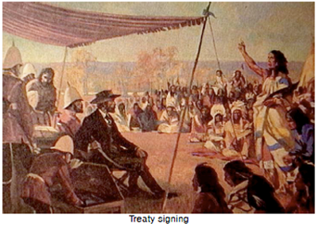

Slide 16
The Consequences of Contact
Aboriginal life changed drastically due to:
1. The Fur Trade.
First Nations hunted animals for pelts, not for their own way of life, so herds started dying out.
Therefore, First Nations had to rely more heavily on European goods since their sources of food were no longer available.

Slide 17
2. European colonization
Forests were destroyed
Land was fenced off
European settlers did not share the coastline
European settlers thought their economic and political system, and religions beliefs were superior to the Aboriginals.

Slide 18
La pire conséquence: Les Béothuks
Les Béothuks étaient un groupe autochtone qui vivaient à l’île de Terre Neuve.
Leur économie et mode de vie a changé assez drastiquement pendant le période de contact, qu’ils n’existaient pas maintenant.
Tournez à p. 39 du texte et fait la feuille du travail.

